Slide 1



Om AI i undervisningen
- att förklara hur AI fungerar
Linda Mannila
linda.mannila@helsinki.fi
Notes:
Many middle schoolers engage with AI-driven social media platforms that use AI to curate content, influencing students’ future visions of the self and society. These students are the first generation whose education, healthcare, and spare time are increasingly mediated by AI-powered applications (UNICEF 2021). In parallel, different AI technologies are being introduced in schools to monitor students, manage groups, automate grading, and deliver data-driven instructions through AI chatbots and intelligent tutoring systems, raising various ethical concerns related to privacy and security, the risks of bias and fairness, transparency, and teacher and student relations (Crompton and Burke 2022; Selwyn et al. 2023; Stenliden and Sperling 2024). The key problematic is how to best prepare this generation, in their transformation from children to lifelong learners, with sound and appropriate knowledge about AI and its effects.

Slide 2


För 10 år sedan…
Vad behöver vi förstå om datorer?
Vad behöver vi göra för att få datorn att jobba för oss?
Hur formar datorer hur vi ser på världen?
Vad är datorer inte bra för?
Vad borde man lära sig om datorer i olika åldrar?
Guzdial, M. (2015). Learner-Centered Design of Computing Education: Research on Computing for Everyone. Synthesis Lectures on Human-Centered Informatics. Morgan & Claypool, CA, USA.
Notes:
CT tries to answer at least some of these questions.
Much of CT is specifically aimed at figuring out how to get a computer to those jobs for us, and algorithms are the procedures that specify how the computer should do them.

Slide 3
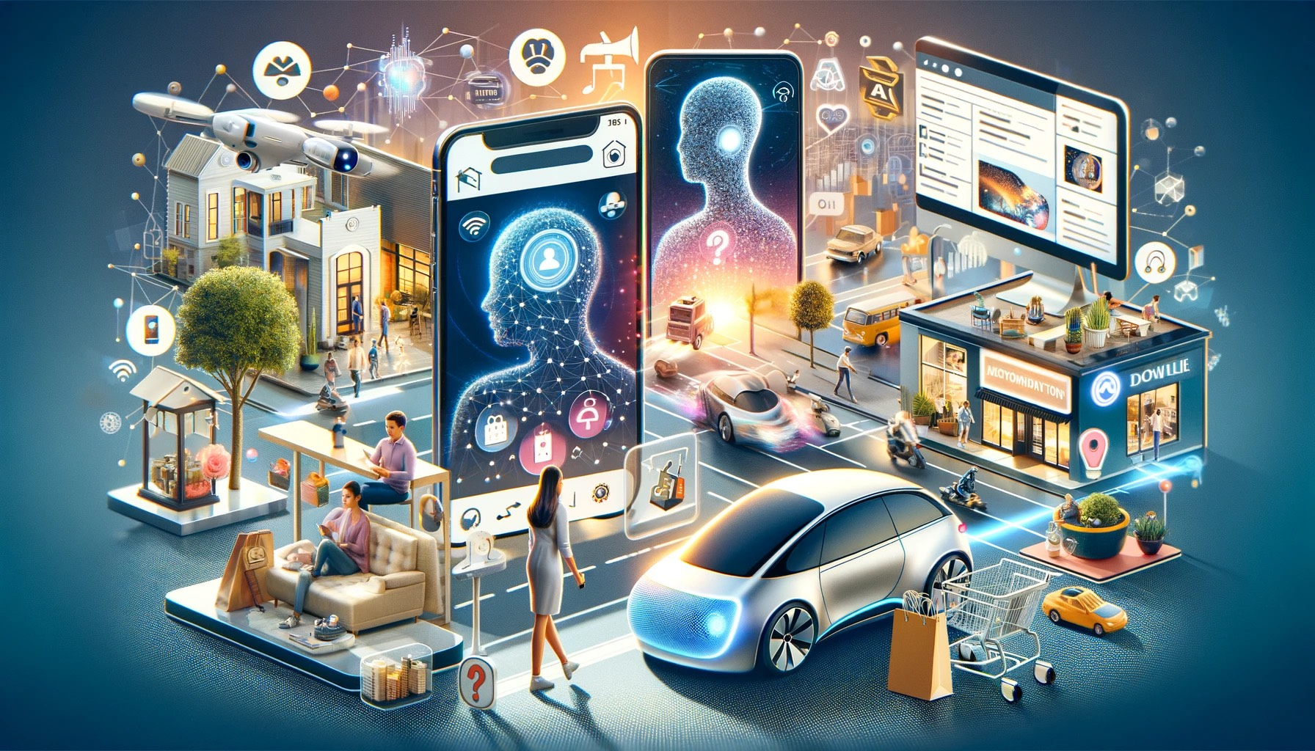
“Take X, add AI”
Kevin Kelly, “The Inevitable”
Notes:
Också 2016, grundare för Wired

Slide 4
Idag…
Vad behöver vi förstå om AI?
Vad behöver vi göra för att få AI att jobba för oss?
Hur formar AI hur vi ser på världen?
Vad är AI inte bra för?
Vad borde man lära sig om AI i olika åldrar?
Guzdial, M. (2015). Learner-Centered Design of Computing Education: Research on Computing for Everyone. Synthesis Lectures on Human-Centered Informatics. Morgan & Claypool, CA, USA.
Notes:
CT tries to answer at least some of these questions.
Much of CT is specifically aimed at figuring out how to get a computer to those jobs for us, and algorithms are the procedures that specify how the computer should do them.

Slide 5


ailit.fi
Samskapande med lärare, elever och lärarutbildare
Skolans realiteter som utgångspunkt
Samarbete med Experience Lab / ÅAU.
Finansierat av Svenska kulturfonden.
Notes:
The process involves four stakeholder groups –– students, teachers, IT educators and teacher trainers – with varying degrees of participation throughout four phases:
co-ideation, co-design, co-implementation, and co-evaluation

Slide 6
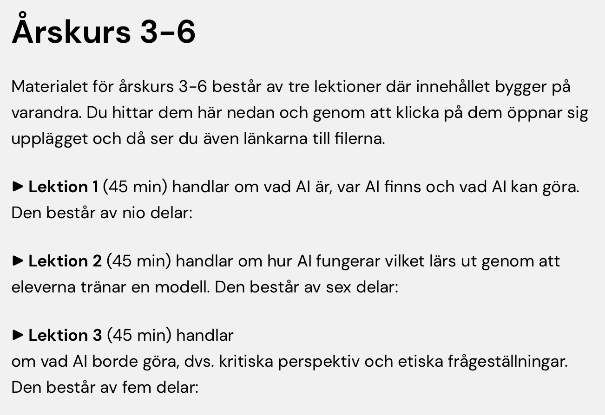
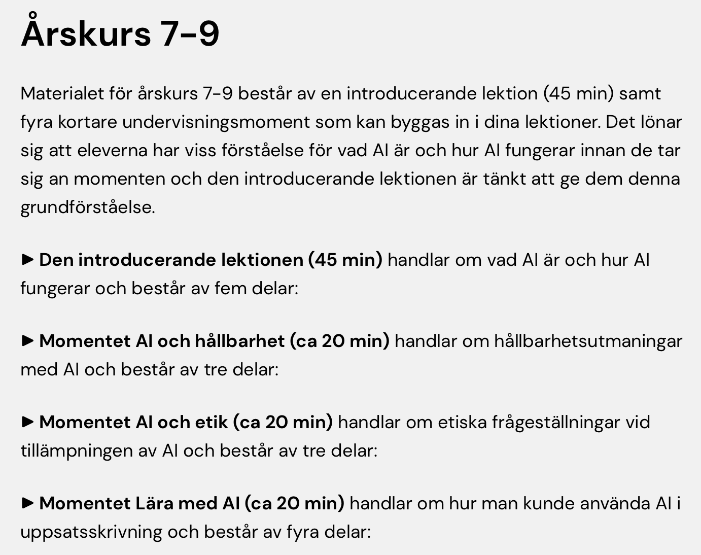
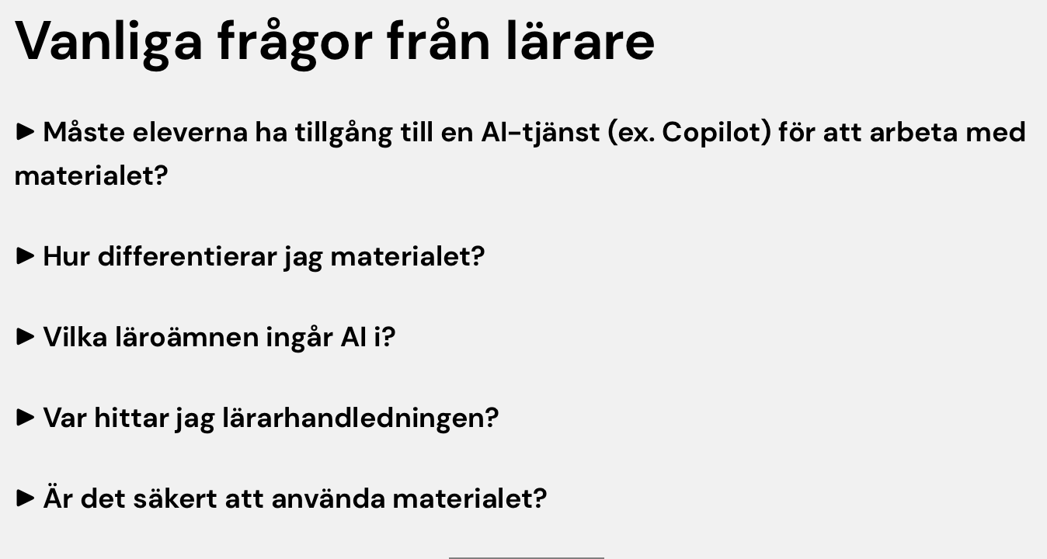
ailit.fi
Notes:
CT tries to answer at least some of these questions.
Much of CT is specifically aimed at figuring out how to get a computer to those jobs for us, and algorithms are the procedures that specify how the computer should do them.

Slide 7

Vad vi ska göra…
[Exempel]
Glasskiosken Strutkungen vill få bättre koll på sin försäljning. Vi ska bygga en matematisk modell som förutspår hur många glassar de säljer. Samtidigt lär vi oss om hur AI-modeller fungerar.
1
2
3
4
Börja enkelt
Hitta mönstret
Bygg en ny modell
Möt verkligheten
Räkna ut ett medelvärde,
det blir vår första modell.
Lägg till mer information
och se vad som händer.
Rita en linje och tolka vad
k och m betyder.
Justera modellen i vårt
interaktiva verktyg
- vad lär du dig?

Slide 8
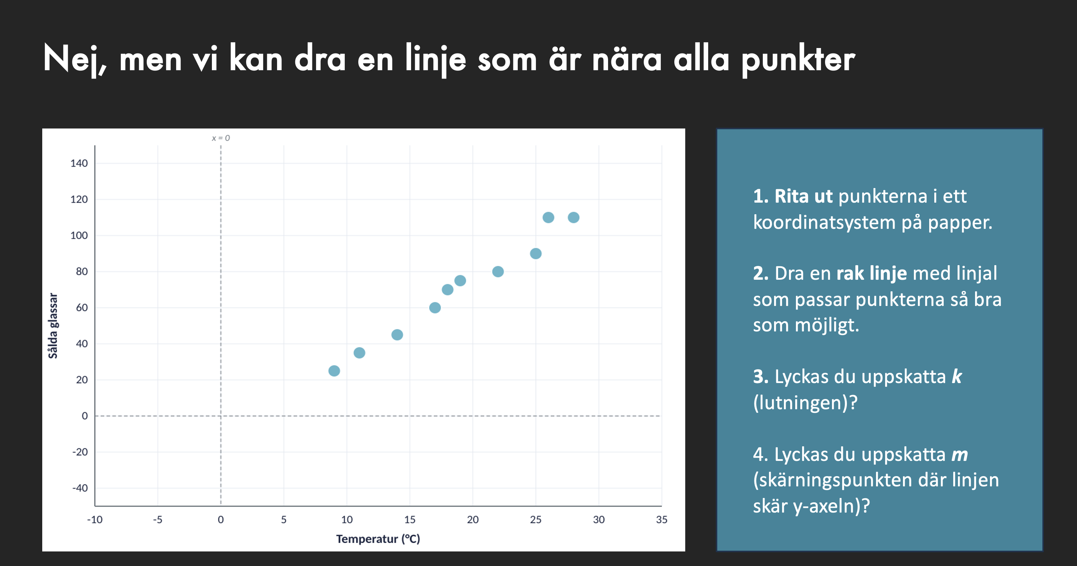
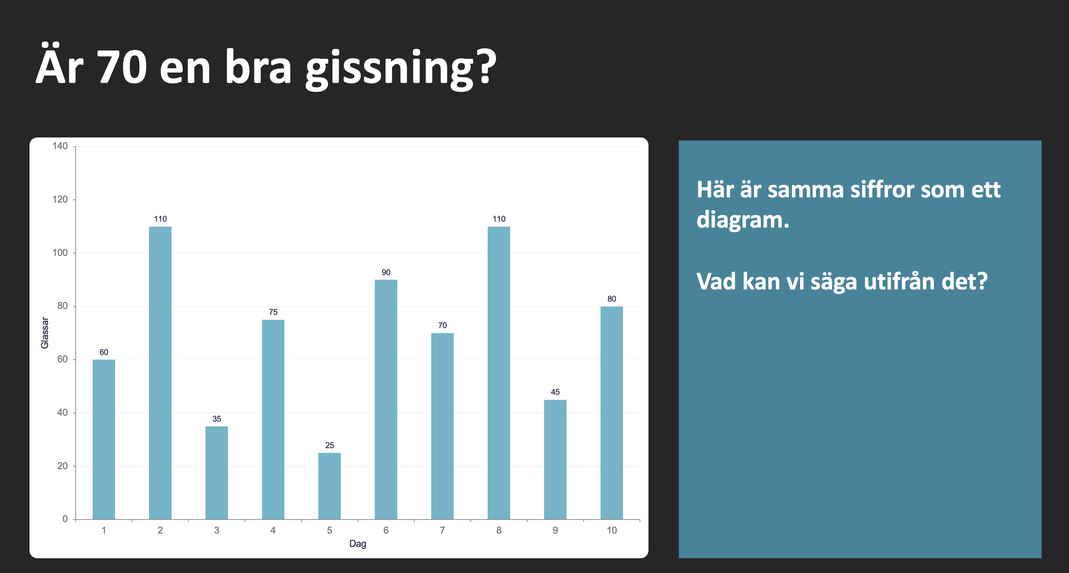
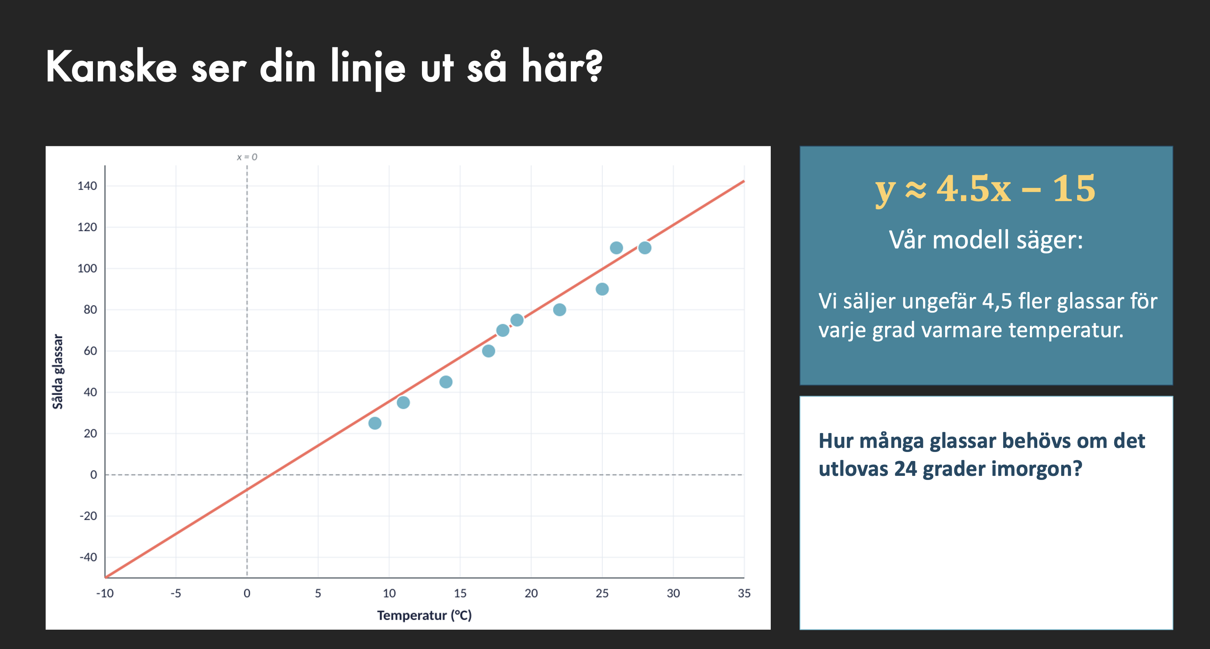
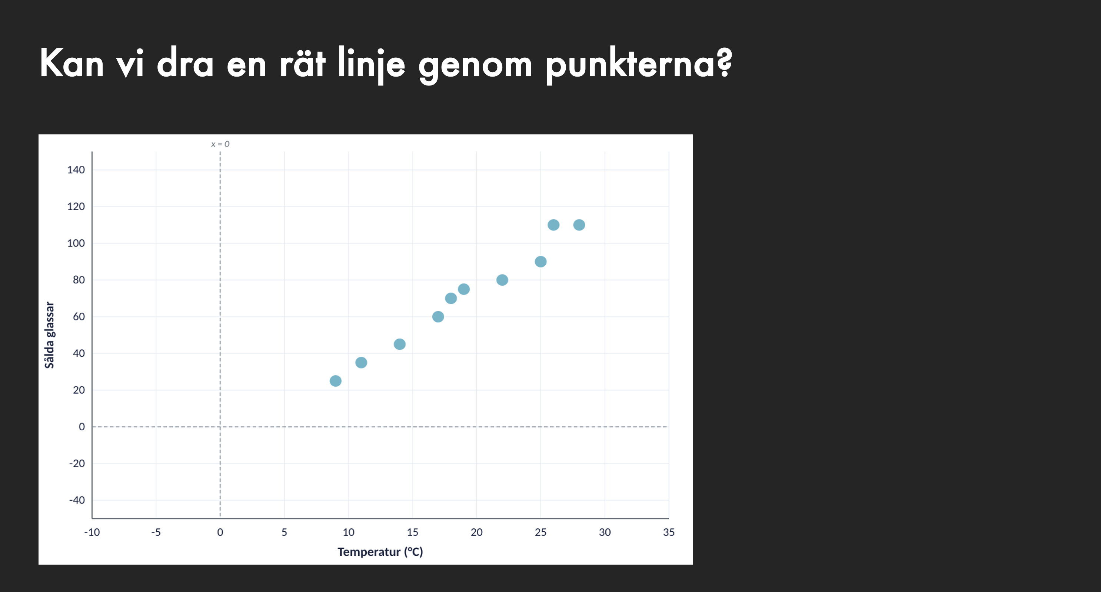
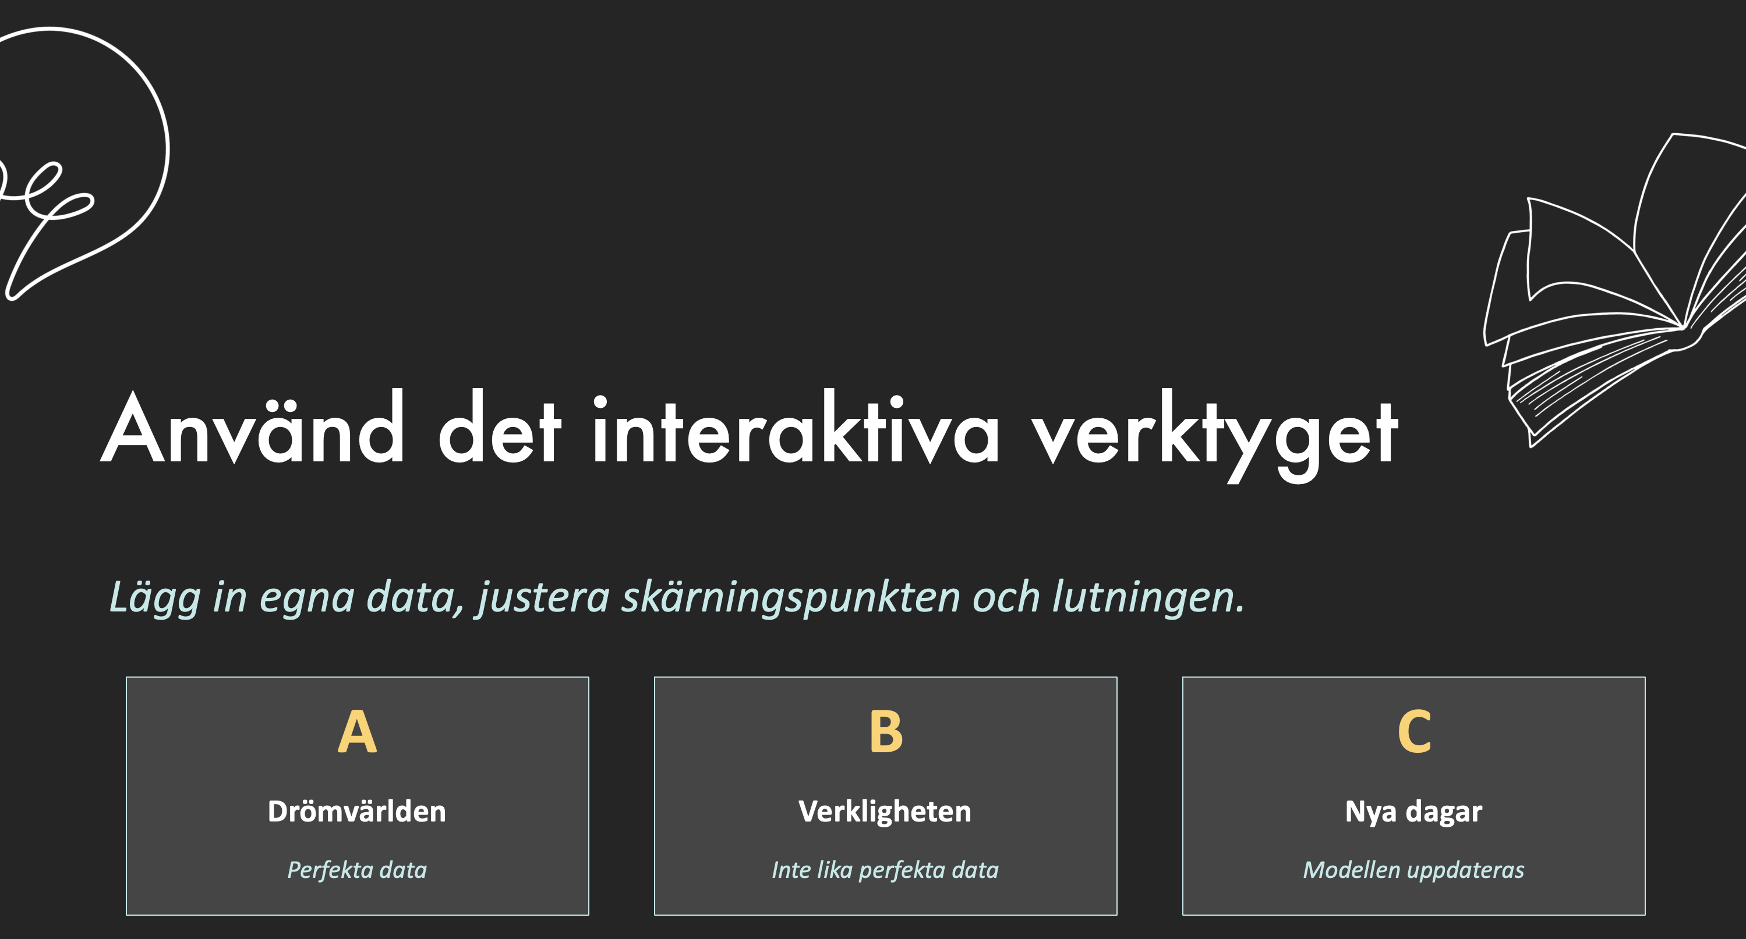
[Exempel]

Slide 9
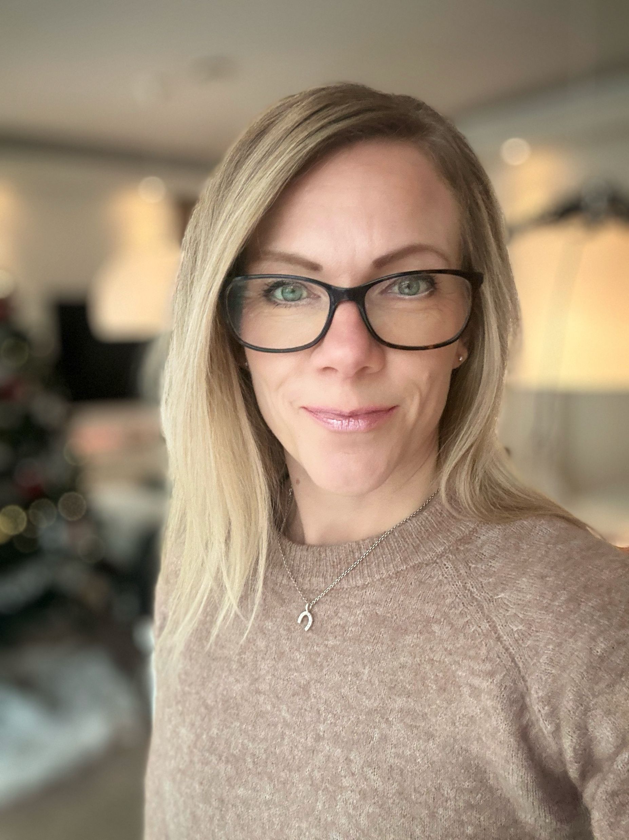
Tack!
Linda Mannila
linda.mannila@helsinki.fi
Notes:
Today’s children are the first generation to grow up with AI seamlessly integrated into their daily lives, benefiting from its opportunities, while also facing AI-related risks such as privacy invasion, exposure to biased or harmful content, manipulation, and over-dependency. As a result, developing AI competences – or AI literacy – is increasingly recognised as a critical component of K-12 education. However, integrating AI literacy poses challenges due to the unfamiliarity of the topic among most educators and the lack of consensus on what to teach, when and how. In this talk, I will share insights from our work on co-designing an AI literacy curriculum for middle school students (grades 3–6) and framing AI literacy for K-12 education through an international multi-perspective expert panel.

